Slide 1

Review of Quiz – I Syllabus
Dr. J. Venkatramani
219-B
venkatramani@iiitdm.ac.in

Slide 2
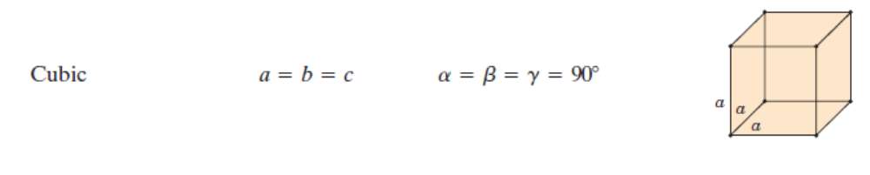
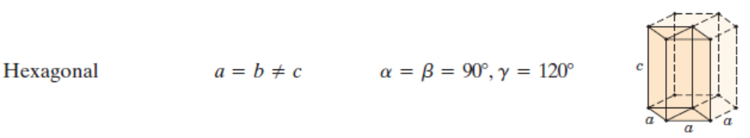
Crystal Systems – Based on Unit Cell Geometry
Based on Unit Cell Geometry there are SEVEN crystal systems.

Slide 3
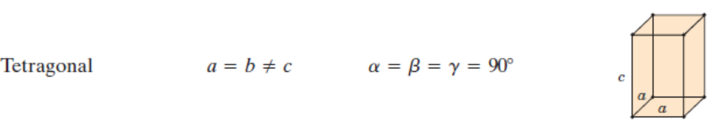
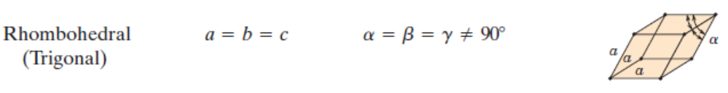
Crystal Systems – Based on Unit Cell Geometry
Based on Unit Cell Geometry there are SEVEN crystal systems.

Slide 4
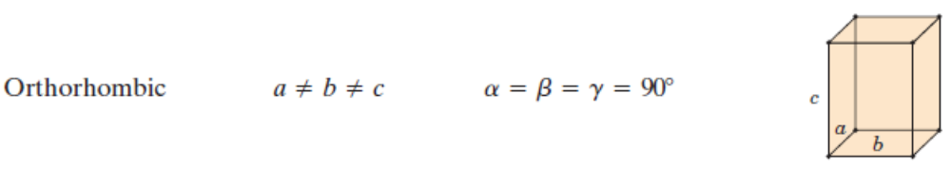
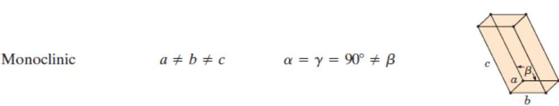
Crystal Systems – Based on Unit Cell Geometry
Based on Unit Cell Geometry there are SEVEN crystal systems.

Slide 5
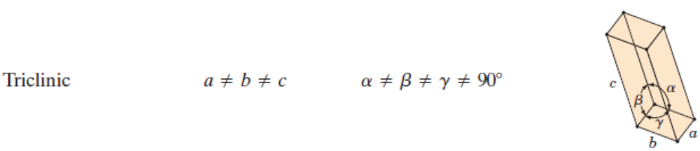
Crystal Systems – Based on Unit Cell Geometry
Based on Unit Cell Geometry there are SEVEN crystal systems.

Slide 6
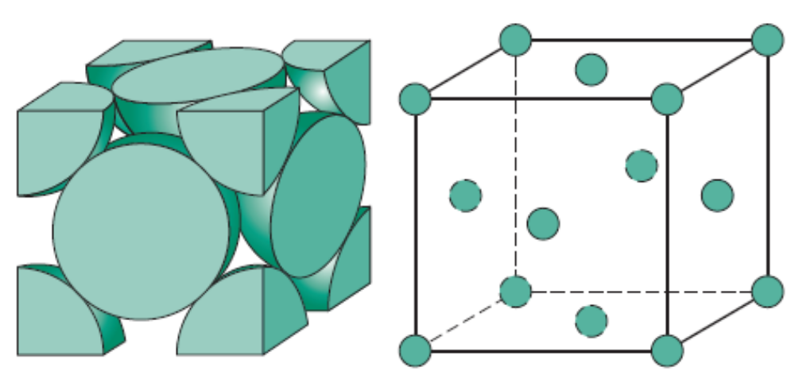
Face–Centered Cubic Crystal Structure
Co – ordination number: 12
Relation between lattice parameter and atomic radius: a = 2√2 R
Atomic Packing Factor: Ratio of volume of the atoms to volume of unit cell = 0.74
The corner atoms and face centered atoms are equivalent. One can move the lattice such that face centered become corner and the corner become face centered.

Slide 7
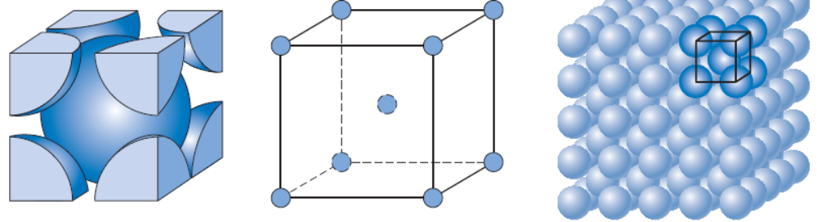
Body–Centered Cubic Crystal Structure
Co – ordination number: 8
Relation between lattice parameter and atomic radius: a = 4R/√3
Atomic Packing Factor: Ratio of volume of the atoms to volume of unit cell = 0.68
Translating the cube such that one of the corners coincide with the body centered atom will not alter the crystal structure

Slide 8
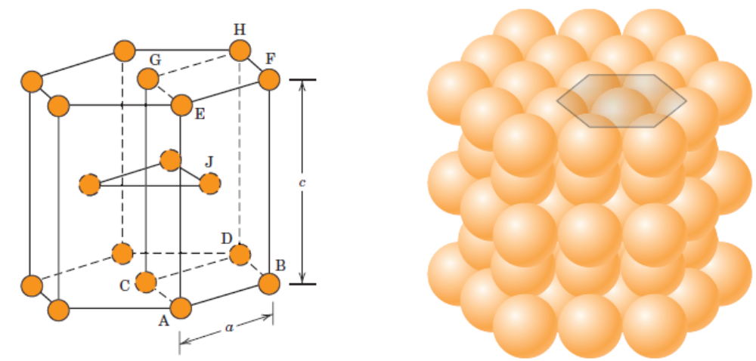
Hexagonal Close–Packed Crystal Structure
Co – ordination number: 12
Relation between lattice parameter and atomic radius: a = 2R. Additional lattice parameter c = 1.633a for closest packing
Atomic Packing Factor: Ratio of volume of the atoms to volume of unit cell = 0.74
Similar comment about translation of the hexagonal unit cell.

Slide 9
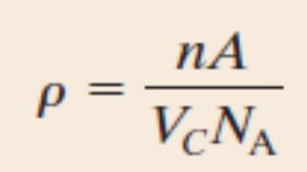
Density Computations
Example: Copper has an atomic radius of 0.128 nm, an FCC crystal structure, and an atomic weight of 63.5 g/mol. Compute its theoretical density and compare the answer with its measured density.

Slide 10
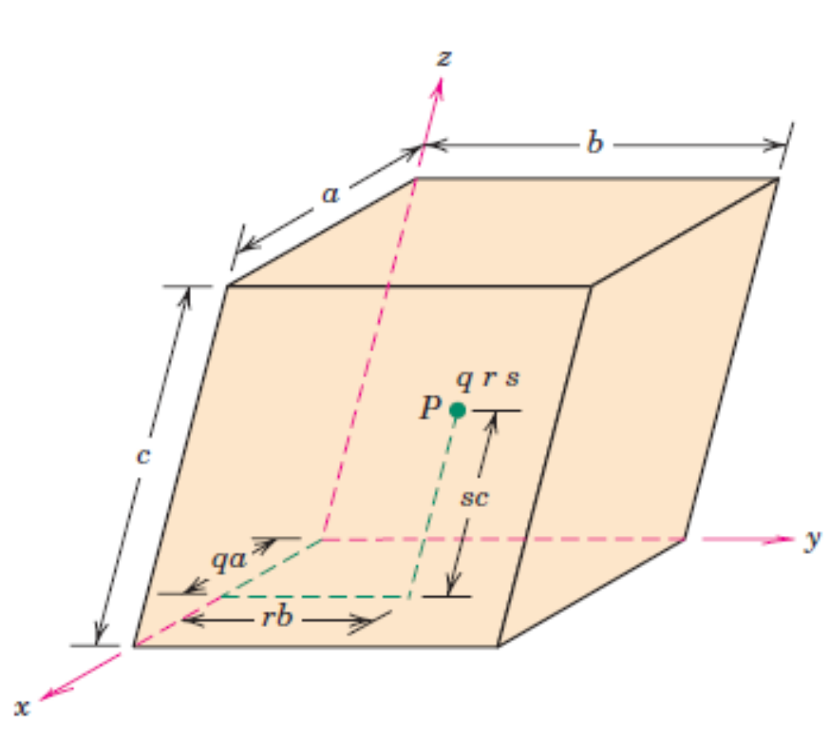
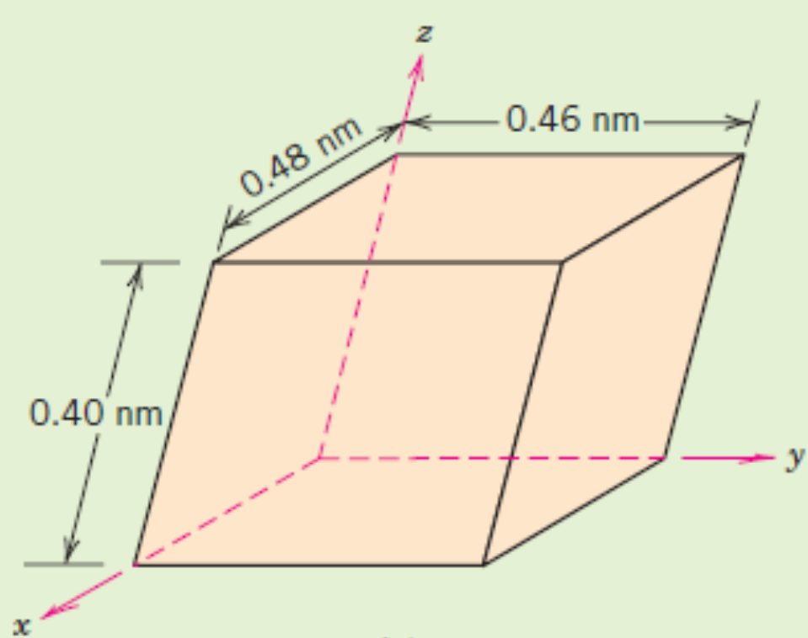
Crystallographic Points, Directions and Planes
A crystallographic point is represented using 3 co–ordinates, but as fractional multiples of unit cell lengths.
No commas or parenthesis.
Example: Locate ¼ 1 ½ in the above unit cell.

Slide 11
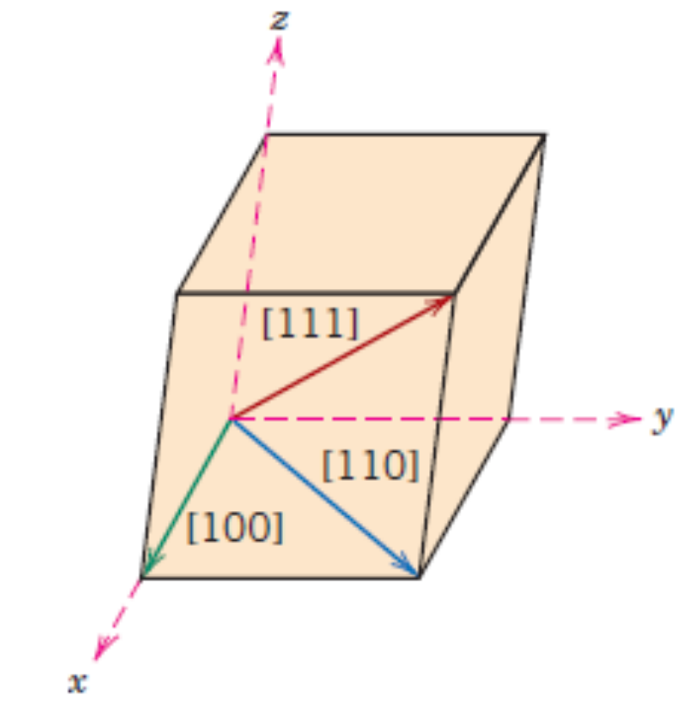
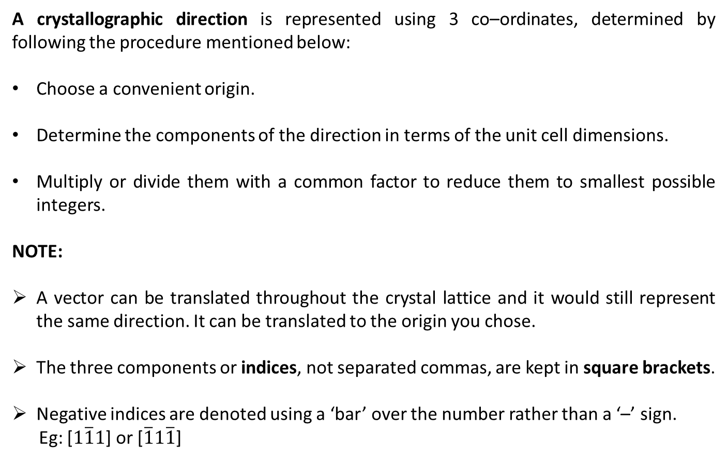
Crystallographic Points, Directions and Planes
A crystallographic direction is represented using 3 co–ordinates, determined by following the procedure mentioned below:
Choose a convenient origin.
Determine the components of the direction in terms of the unit cell dimensions.
Multiply or divide them with a common factor to reduce them to smallest possible integers.
NOTE:
A vector can be translated throughout the crystal lattice and it would still represent the same direction. It can be translated to the origin you chose.
The three components or indices, not separated commas, are kept in square brackets.
Negative indices are denoted using a ‘bar’ over the number rather than a ‘–’ sign.
Eg: [$1\overline{1}1$] or [$\overline{1}1\overline{1}$]

Slide 12
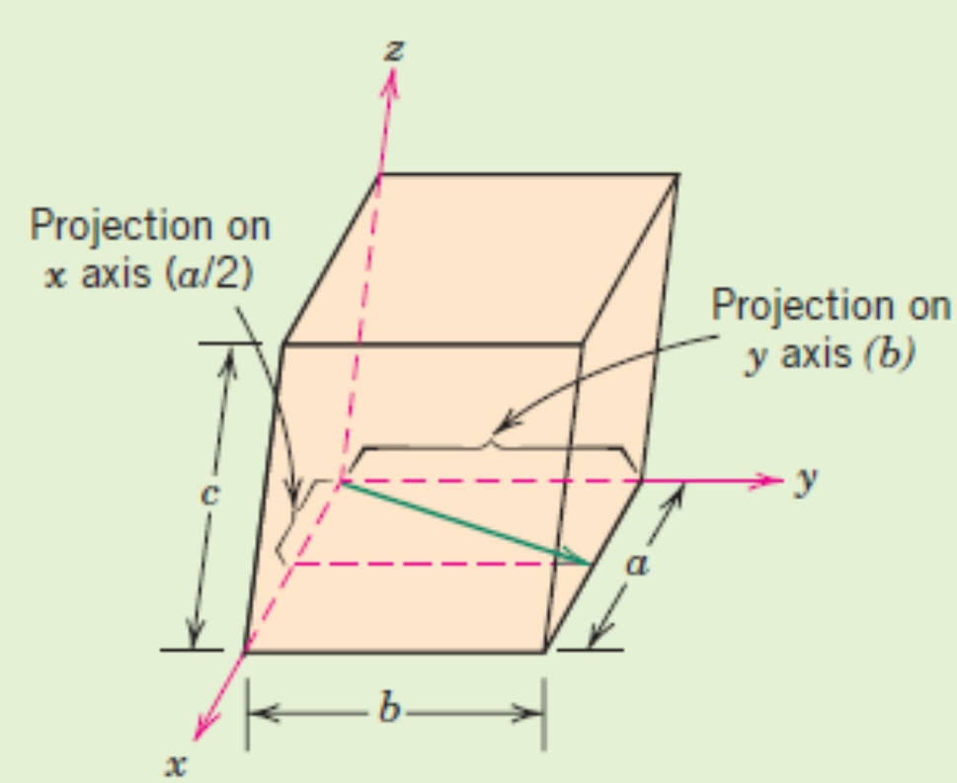
Crystallographic Points, Directions and Planes
Example 1: Determine the crystallographic direction in the figure shown.
Example 2: Draw the crystallographic direction corresponding to [1 2 1] and [2 1 1] directions.

Slide 13
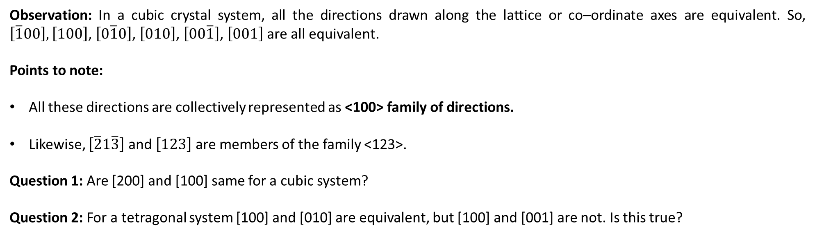
Family of Crystallographic Directions
Observation: In a cubic crystal system, all the directions drawn along the lattice or co–ordinate axes are equivalent. So, $\left[\overline{1}00\right],\left[100\right]$, $\left[0\overline{1}0\right]$, $\left[010\right]$, $\left[00\overline{1}\right]$, $\left[001\right]$ are all equivalent.
Points to note:
All these directions are collectively represented as <100> family of directions.
Likewise, $\left[\overline{2}1\overline{3}\right]$ and $\left[123\right]$ are members of the family <123>.
Question 1: Are [200] and [100] same for a cubic system?
Question 2: For a tetragonal system [100] and [010] are equivalent, but [100] and [001] are not. Is this true?

Slide 14
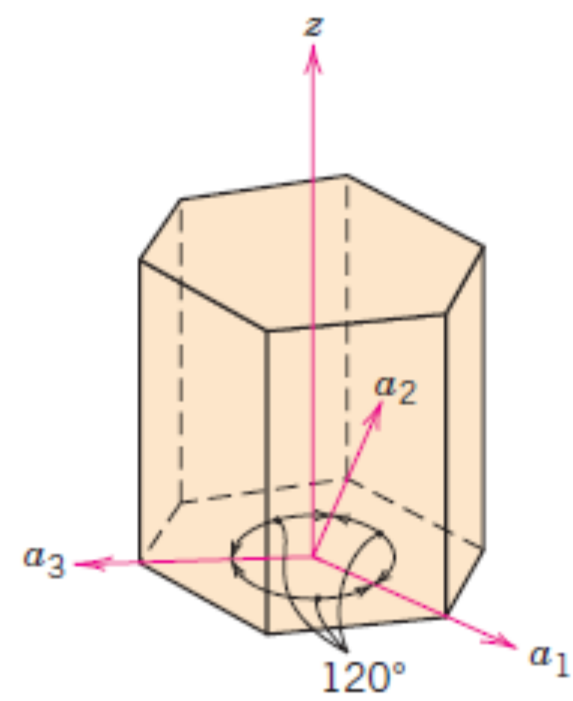
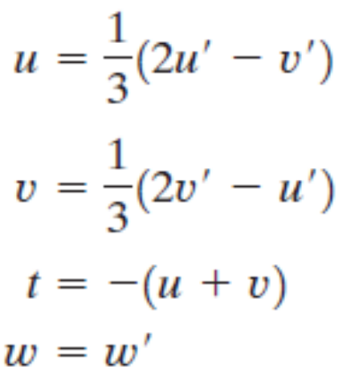
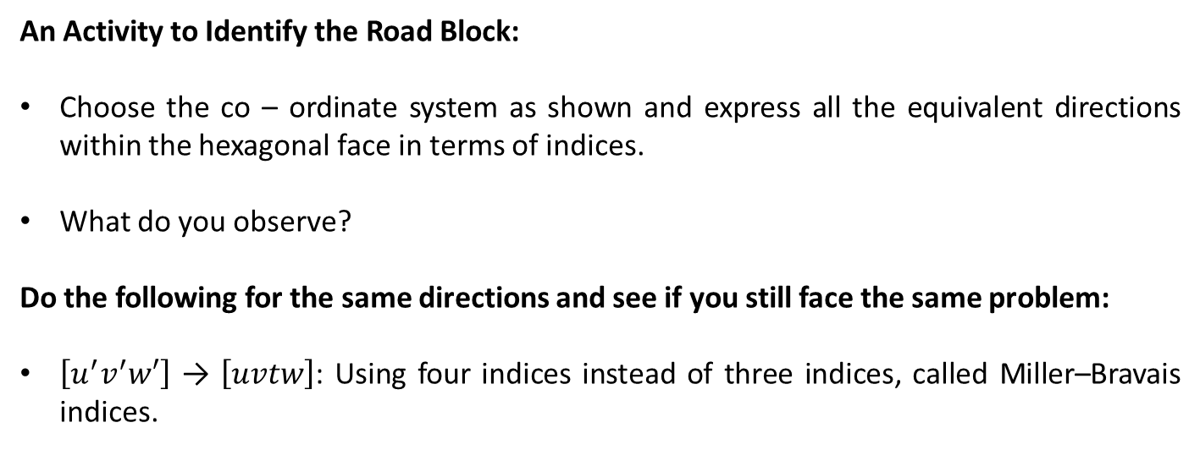
Crystallographic Directions For Hexagonal Crystals
An Activity to Identify the Road Block:
Choose the co – ordinate system as shown and express all the equivalent directions within the hexagonal face in terms of indices.
What do you observe?
Do the following for the same directions and see if you still face the same problem:
$\left[u^{′}v^{′}w′\right]$ → $\left[uvtw\right]$: Using four indices instead of three indices, called Miller–Bravais indices.

Slide 15
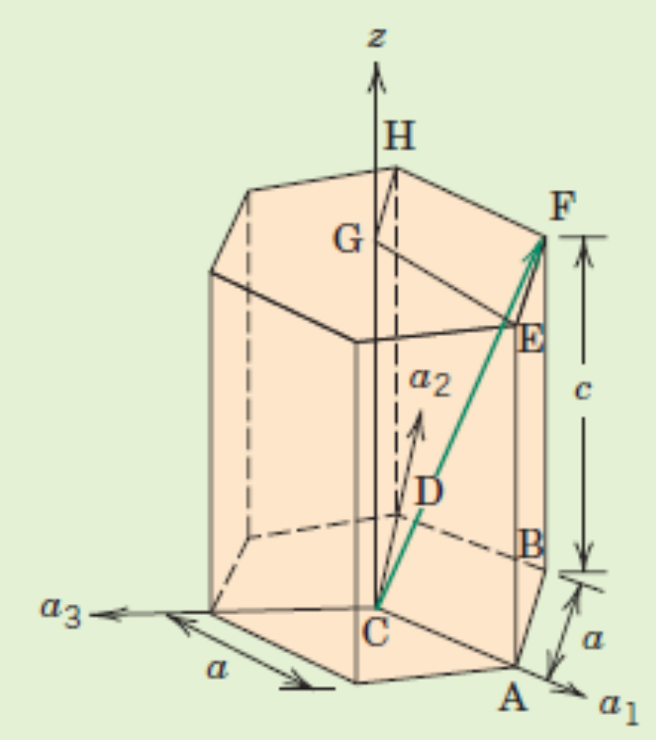
Crystallographic Directions For Hexagonal Crystals
Example: Find the indices of the directions shown

Slide 16
Crystallographic Planes
We would like to express a crystallographic planes in terms of 3 indices (hkl) in a manner similar to co–ordinate geometry of planes where we use direction cosines of the normal to denote a plane. These three indices are called Miller Indices.
If the plane passes through the selected origin, either another parallel plane must be constructed within the unit cell by an appropriate translation, or a new origin must be established at the corner of another unit cell.
At this point the crystallographic plane either intersects or parallels each of the three axes; the length of the planar intercept for each axis is determined in terms of the lattice parameters a, b, and c.
The reciprocals of these numbers are taken. A plane that parallels an axis may be considered to have an infinite intercept, and, therefore, a zero index.
If necessary, these three numbers are changed to the set of smallest integers by multiplication or division by a common factor.
Finally, the integer indices, not separated by commas, are enclosed within parentheses, thus: (hkl).

Slide 17
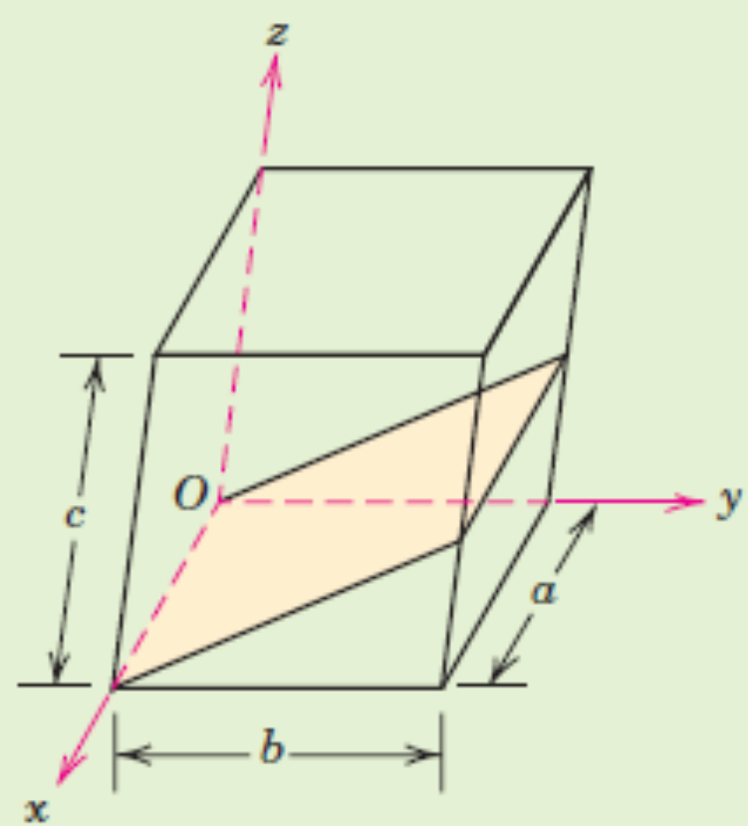
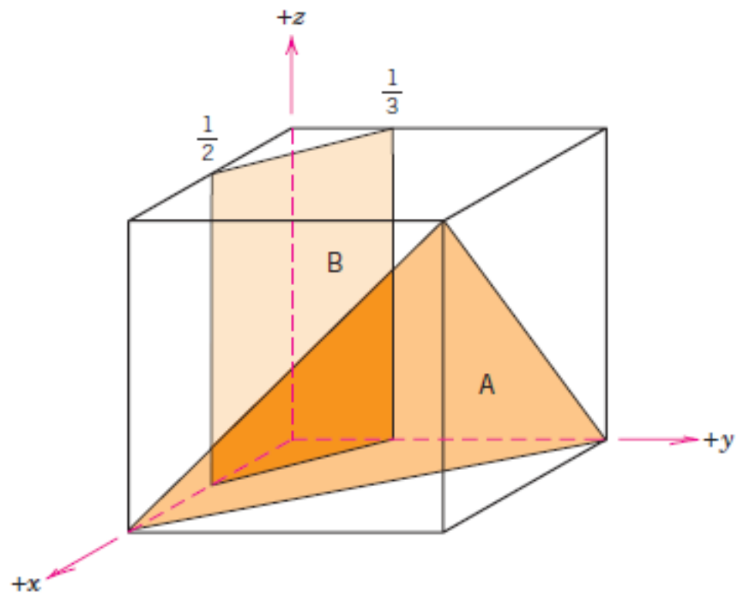
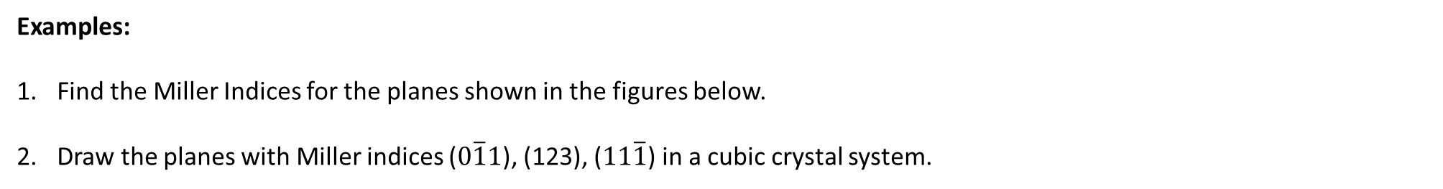
Crystallographic Planes
Examples:
Find the Miller Indices for the planes shown in the figures below.
Draw the planes with Miller indices ($0\overline{1}1$), (123), ($11\overline{1}$) in a cubic crystal system.

Slide 18
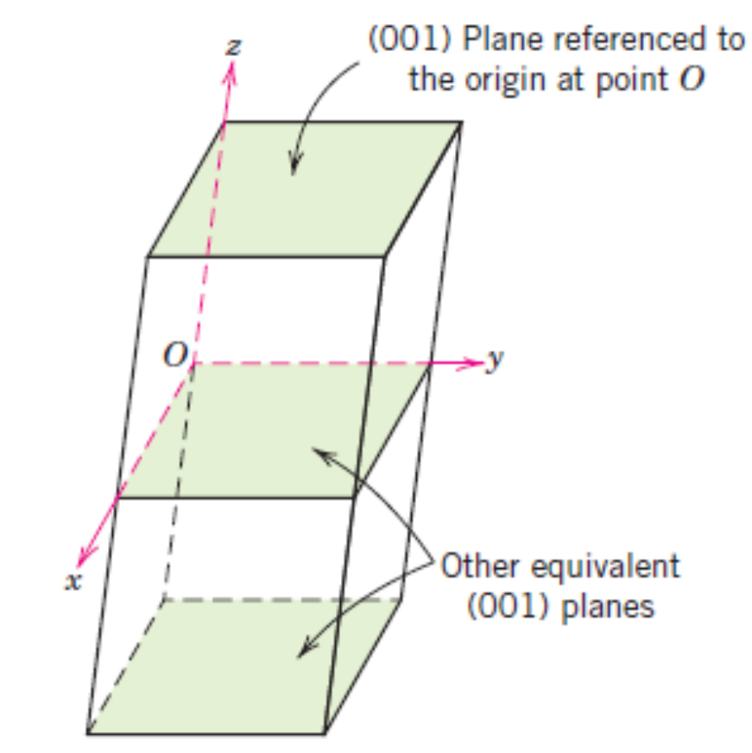
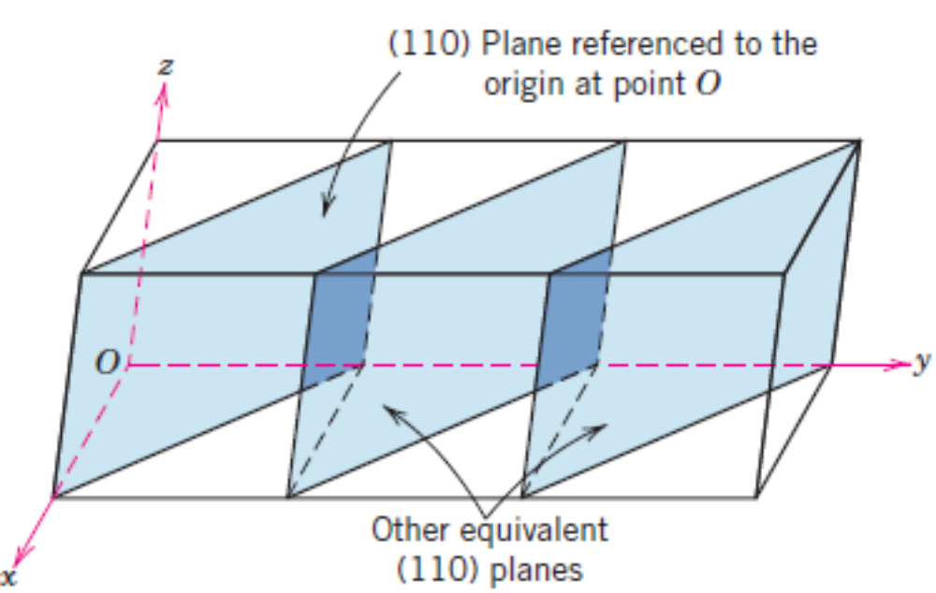
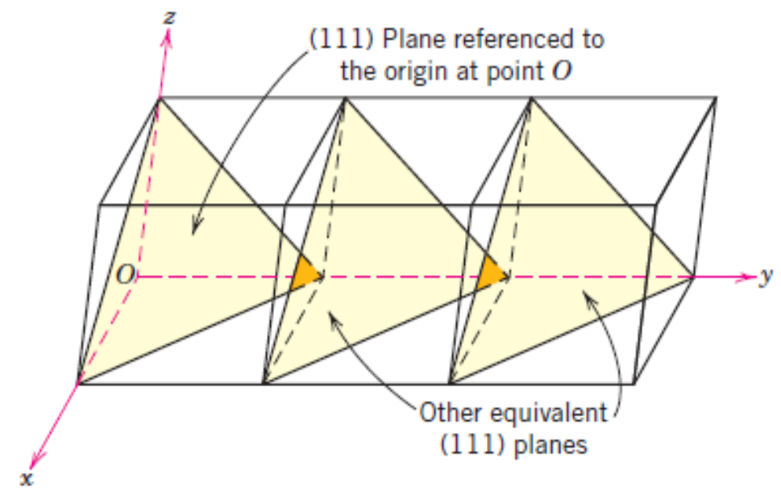
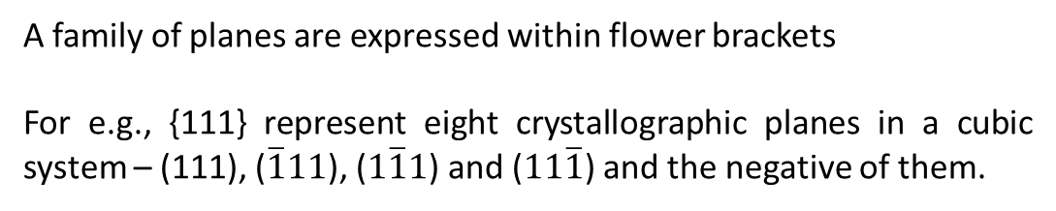
Crystallographic Planes – Equivalent planes
A family of planes are expressed within flower brackets
For e.g., {111} represent eight crystallographic planes in a cubic system – (111), ($\overline{1}11$), ($1\overline{1}1$) and ($11\overline{1}$) and the negative of them.

Slide 19
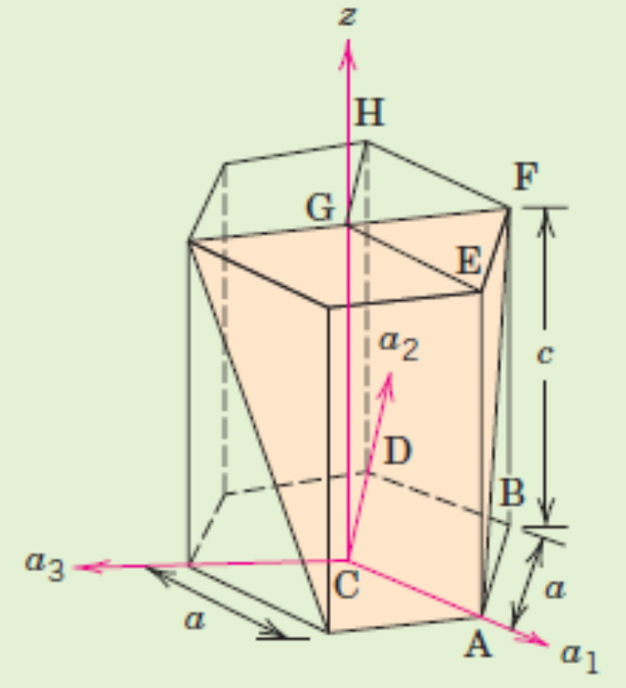
Crystallographic Planes – Hexagonal Crystals
Even while representing planes, we need to introduce an additional, dependent co–ordinate in order that a family of planes contain the same combination of indices.
The indices h k and l are determined first in the same manner as for cubic systems. After this, an additional co – ordinate i is defined as i = –(h + k). The four – index representation for crystallographic planes in Hexagonal systems is (hkil).
E.g., Find the Miller indices of the crystallographic plane shown here.

Slide 20
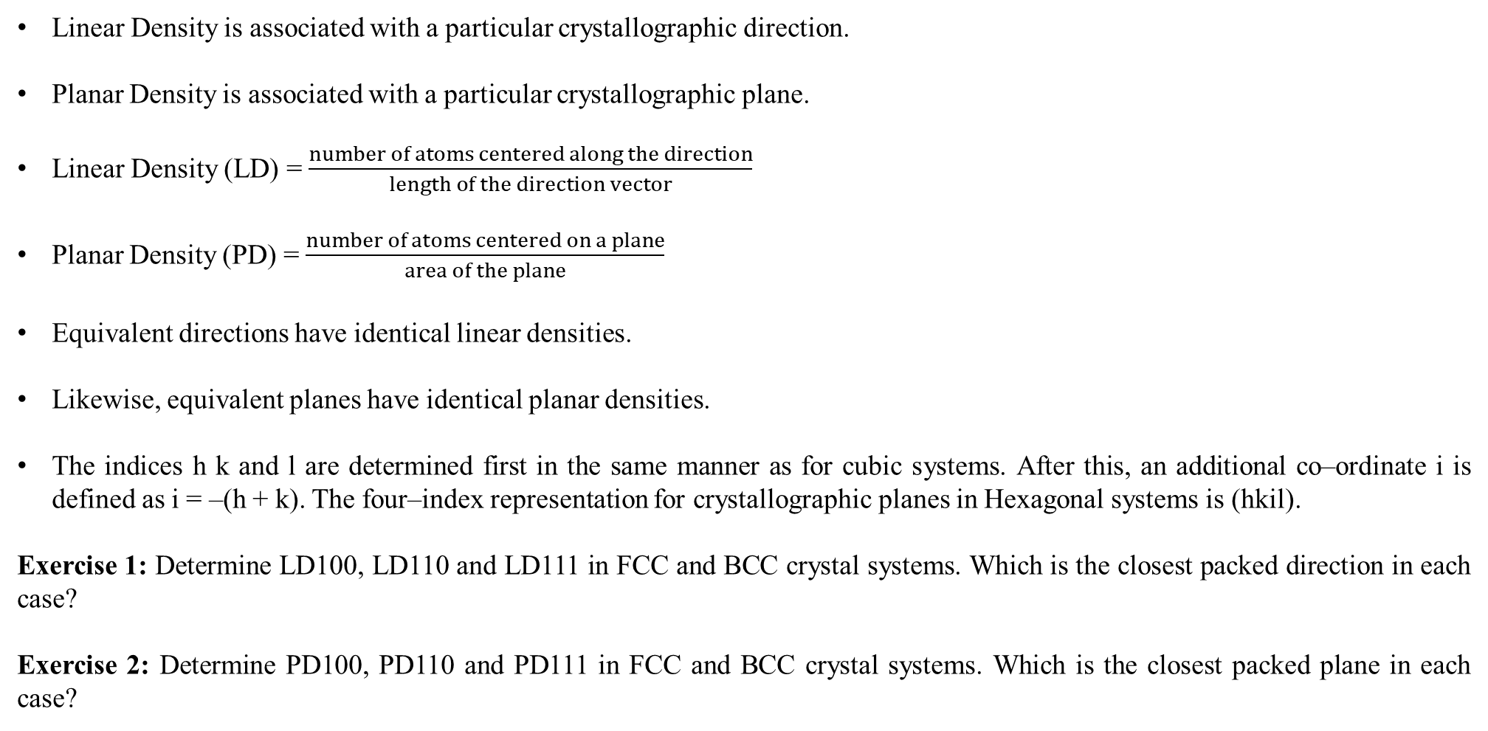
Linear and Planar Densities
Linear Density is associated with a particular crystallographic direction.
Planar Density is associated with a particular crystallographic plane.
Linear Density (LD) = $\frac{number of atoms centered along the direction}{length of the direction vector}$
Planar Density (PD) = $\frac{number of atoms centered on a plane}{area of the plane}$
Equivalent directions have identical linear densities.
Likewise, equivalent planes have identical planar densities.
The indices h k and l are determined first in the same manner as for cubic systems. After this, an additional co–ordinate i is defined as i = –(h + k). The four–index representation for crystallographic planes in Hexagonal systems is (hkil).
Exercise 1: Determine LD100, LD110 and LD111 in FCC and BCC crystal systems. Which is the closest packed direction in each case?
Exercise 2: Determine PD100, PD110 and PD111 in FCC and BCC crystal systems. Which is the closest packed plane in each case?

Slide 21
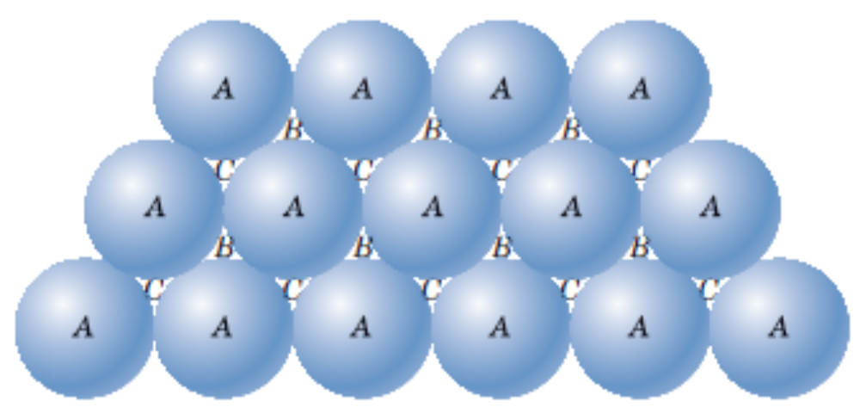
Close – packed Crystal Structures
FCC and HCP are the closest packed, with an Atomic Packing Factor value = 0.74.
In addition to unit cell representation, these two crystal structures can be visualized as stacking of close – packed planes in a certain pattern.
Then, the stacking sequence decides the type of crystal structure.
Can you realize HCP Crystal Structure from this picture? What kind of stacking sequence should we follow hereafter?

Slide 22
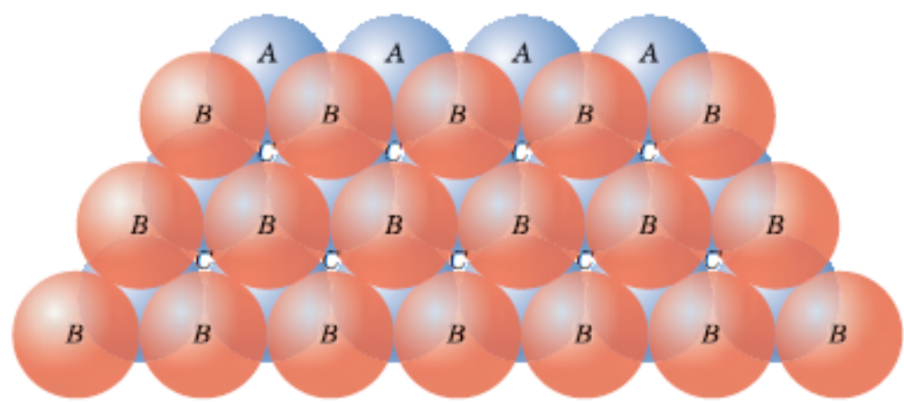
Close – packed Crystal Structures
FCC and HCP are the closest packed, with an Atomic Packing Factor value = 0.74.
In addition to unit cell representation, these two crystal structures can be visualized as stacking of close – packed planes in a certain pattern.
Then, the stacking sequence decides the type of crystal structure.
One can occupy either B or C positions as shown in the picture on the right (pink ‘B’ spheres placed over blue ‘A’ spheres). So, if we occupy B positions, the next layer of atoms can occupy either C or A positions. If we choose A positions, we will get HCP. If we choose C positions we will get FCC.
Therefore, FCC corresponds to ABCABCABC….stacking sequence.
HCP corresponds to ABABAB…..stacking sequence.

Slide 23
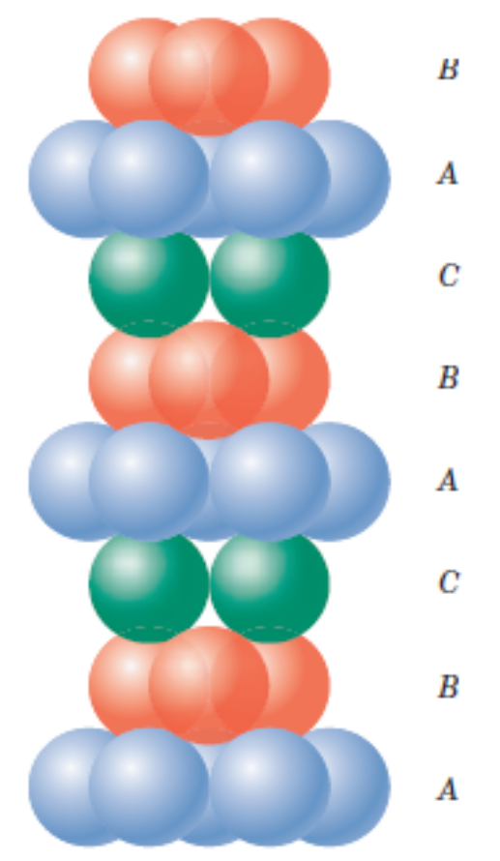
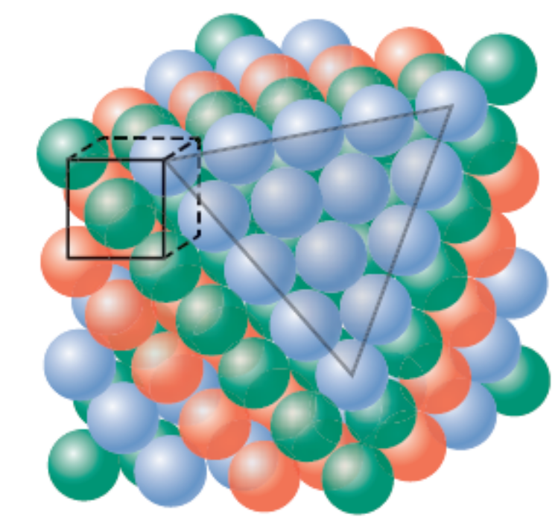
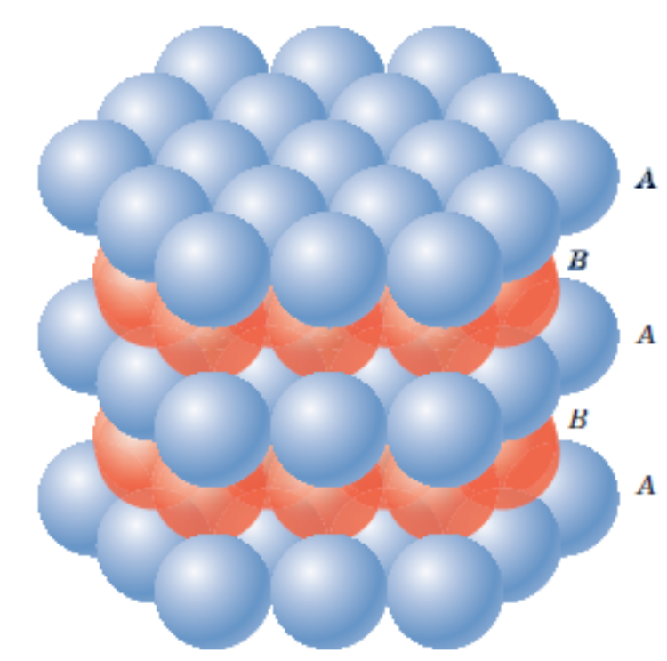
Close – packed Crystal Structures
FCC corresponds to ABCABCABC….stacking sequence. These planes are {111} family.
HCP corresponds to ABABAB…..stacking sequence. These planes are {0001} family.

Slide 24
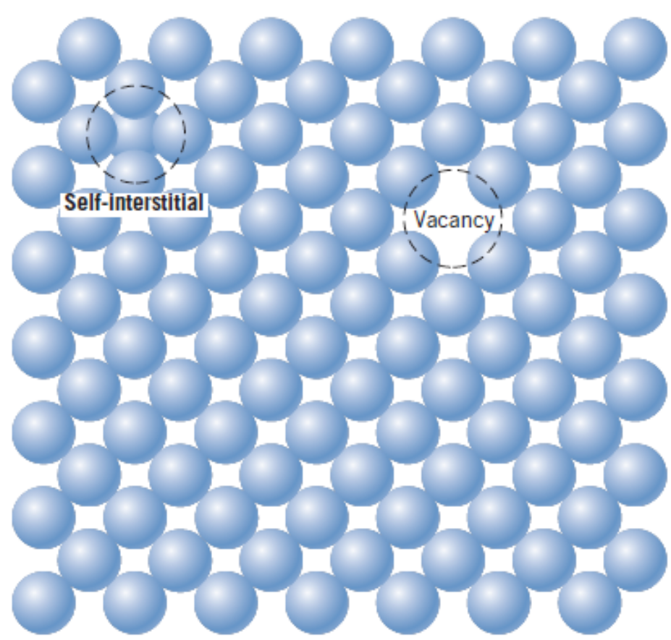
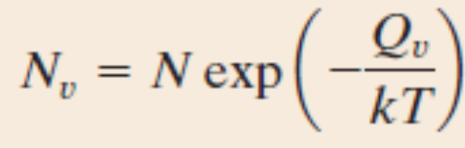
Point Defects
Vacancies
Impurities
Substitutional
Interstitial
Vacancies are driven by thermodynamics.
Factors affecting the type of impurities
  Atomic size
  Crystal structure
  Electronegativity
  Valences

Slide 25
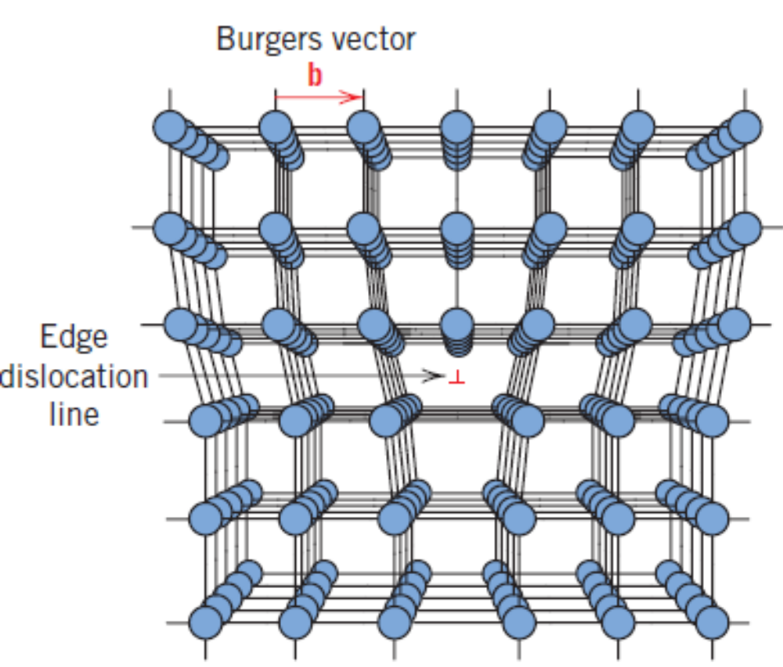
Line Defects – Edge Dislocation
Points to note:
Burger’s vector
Dislocation line
Dislocation motion

Slide 26
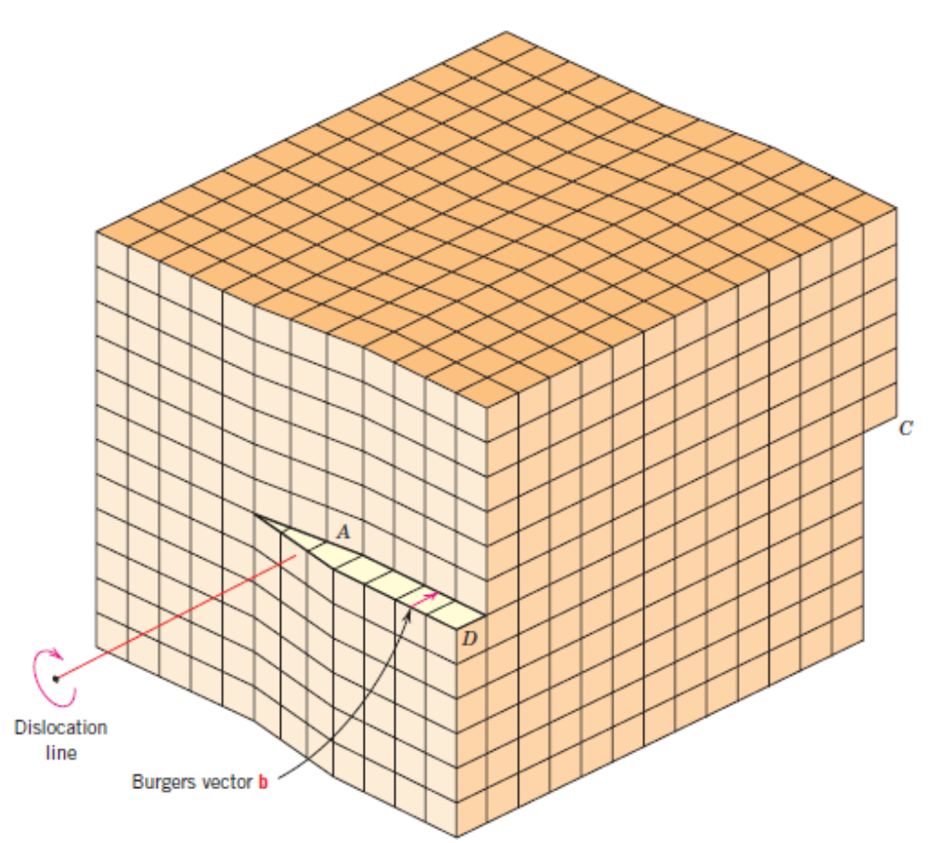
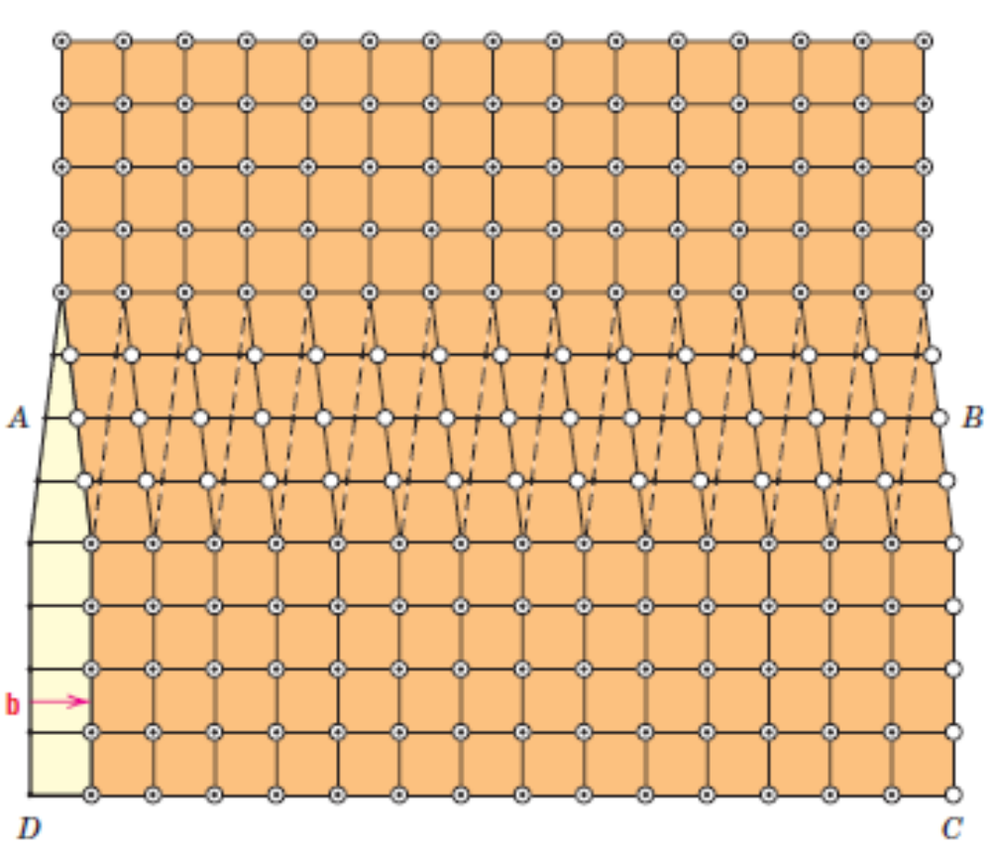
Line Defects – Screw Dislocation

Slide 27
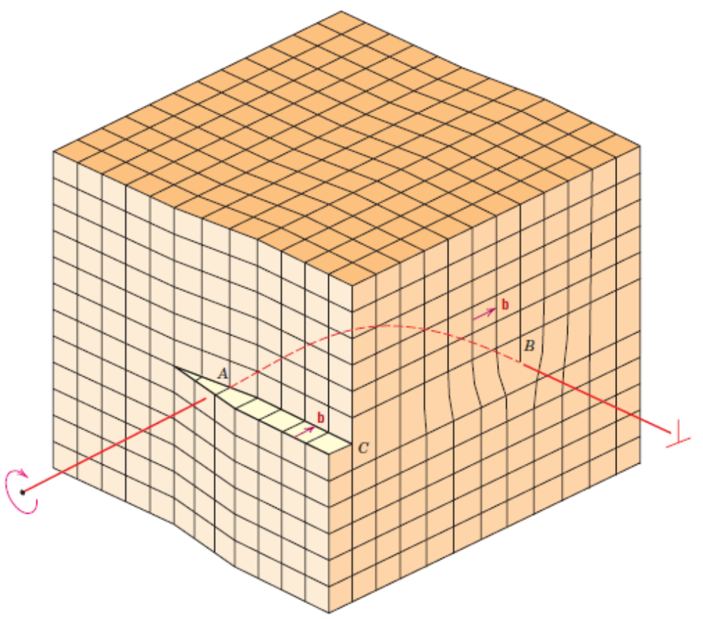
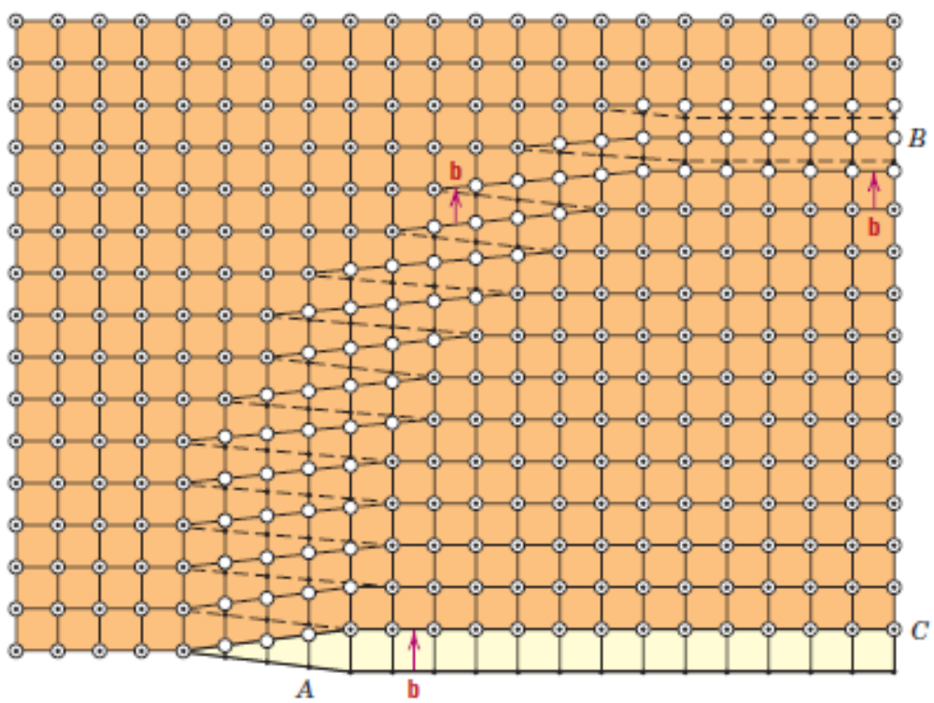
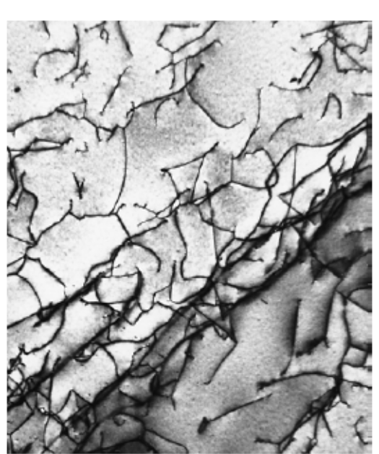
Line Defects – Mixed Dislocation
Transmission Electron Microscopic Image of a Ti alloy

Slide 28
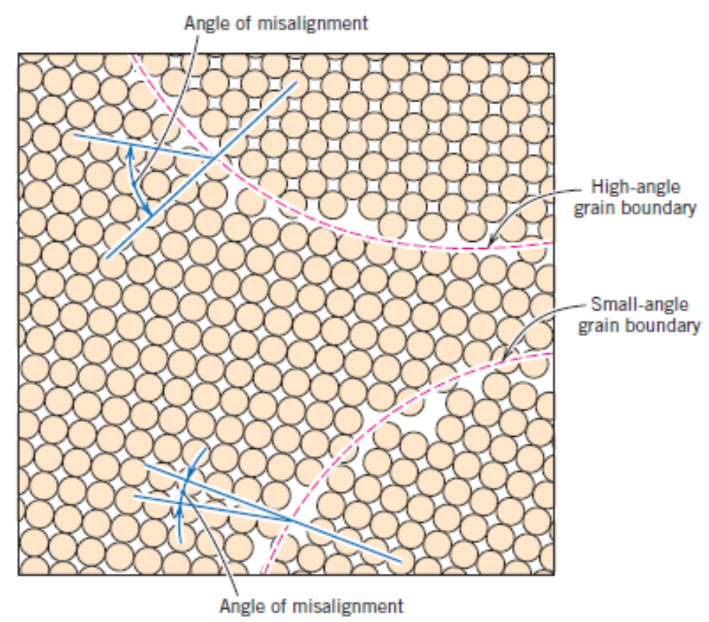
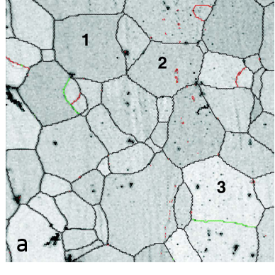
Interfacial Defects – Grain Boundaries
SEM Image of grain boundaries

Slide 29
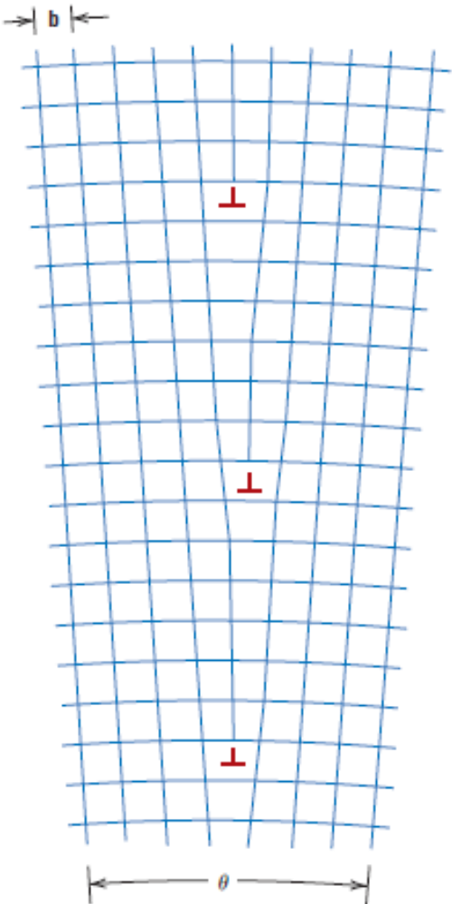
Interfacial Defects – Grain Boundaries
The adjacent figure shows a type of interfacial defect called tilt boundary.
A similar type of defect is twist boundary which can be described using screw type of dislocations.
The atoms along the grain boundaries are less regularly arranged.
Grain boundaries also are at a higher energy state. The magnitude of this energy is function of the degree of the misorientation.
Tilt boundary due to alignment of edge dislocations

Slide 30
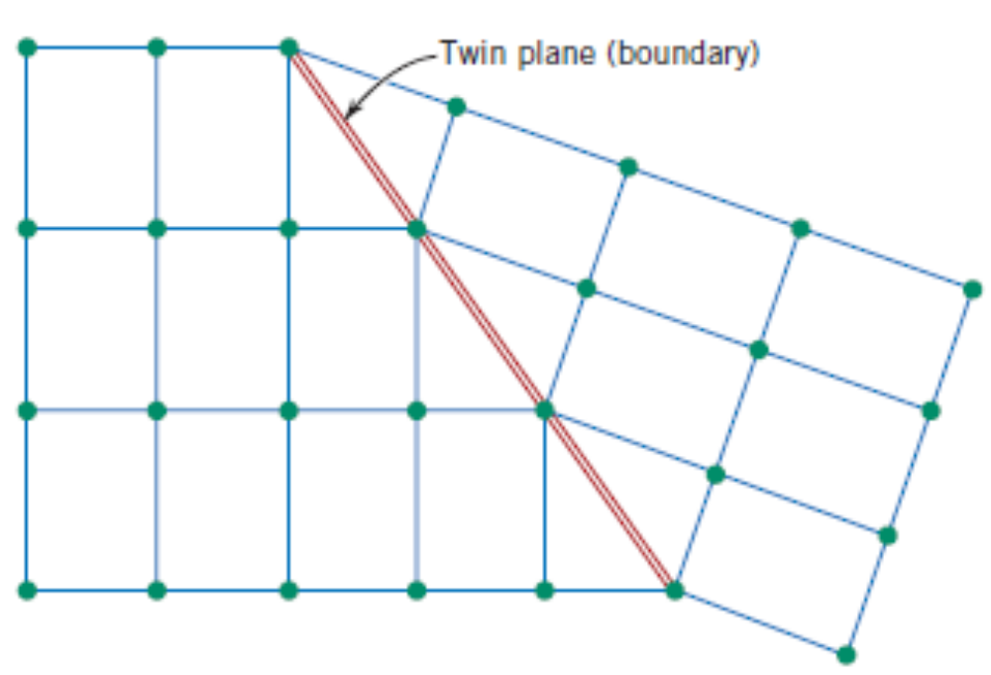
Interfacial Defects – Twin Boundaries

Slide 31
Interfacial Defects – Miscellaneous
A stacking fault – say, in FCC, a break in the sequence of stacking of {111} planes ABCABCABC…
Phase boundaries in multiphase materials.
Ferromagnetic domain walls
Bulk or Volume Defects
Pores, cracks, foreign inclusions and other phases.
Atomic vibrations
Atomic vibrations are also a kind of defect, especially at very high temperatures which affect the properties of a solid.

Slide 32
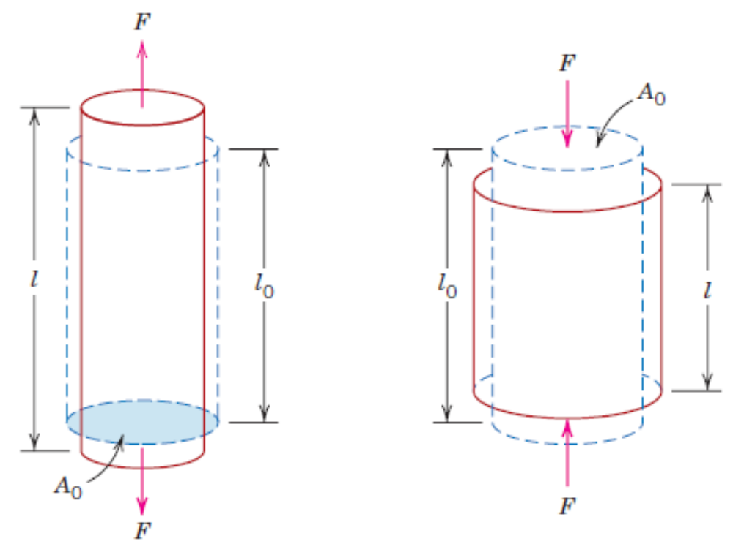
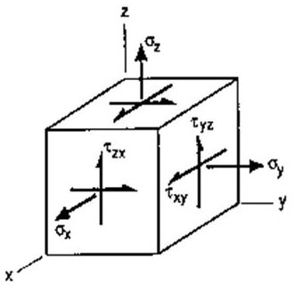
Concept of 3–D State of Stress
State of Stress at a point

Slide 33
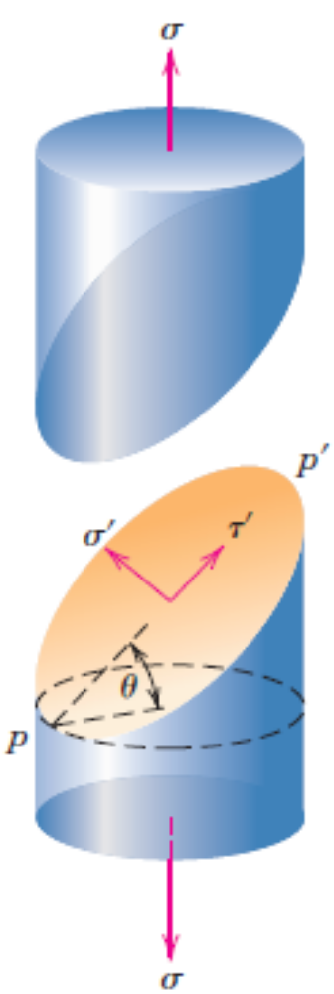

Concept of 3–D State of Stress: Stress components
$$σ^{′}=σ\cos^{2}θ$$
$$τ^{′}=σsin θcos θ$$

Slide 34



Stress – Strain Behaviour
Most of the metals exhibit linear relationship between stress and strain up to a certain limit of stress. This is known as Hooke’s law.

Slide 35


Viewing Elasticity at atomistic length scales
Energy potential as a function of the distance between a pair of atoms
Force between a pair of atoms

Slide 36


Viewing Elasticity at atomistic length scales

Slide 37


Elastic Properties of Materials
Poisson’s ratio (ν): Ratio of lateral strain to longitudinal strain, with a negative sign as in the equation below. The negative sign is to ensure that the value of ν remains positive.

Slide 38

Bi – axial State and relation between Elastic Constants In Isotropic Materials
σ₀
Poisson’s ratio (ν): Ratio of lateral strain to longitudinal strain, with a negative sign as in the equation below. The negative sign is to ensure that the value of ν remains positive.
D
C
y
σ₀
σ₀
A
B
σ₀
x
Note that here, σ_{x} = +σ₀, σ_{y} = $−$σ₀.
Strain along x – direction is $∈_{x}=\frac{σ_{x}}{E}−ν\frac{σ_{y}}{E}=\left(1+ν\right)\frac{σ_{0}}{E}$
Strain along y – direction is $∈_{y}=\frac{σ_{y}}{E}−ν\frac{σ_{x}}{E}=−\left(1+ν\right)\frac{σ_{0}}{E}$

Slide 39


Bi – axial State and relation between Elastic Constants In Isotropic Materials
Note that here, σ_{x} = +σ₀, σ_{y} = $−$σ₀.
Strain along x – direction is $∈_{x}=\frac{σ_{x}}{E}−ν\frac{σ_{y}}{E}=\left(1+ν\right)\frac{σ_{0}}{E}$
Strain along y – direction is $∈_{y}=\frac{σ_{y}}{E}−ν\frac{σ_{x}}{E}=−\left(1+ν\right)\frac{σ_{0}}{E}$
σ₀
D
S
C
y
P
R
σ₀
σ₀
Note that here, σ_{x’} = ?, σ_{y’} = $?$, τ_{x’y’} = ?, τ_{y’x’} = ?
A
Q
B
σ₀
x
y’
σ_{y'}
τ_{y‘x'}
S
R
σ_{x'}
τ_{x'y'}
σ_{x'}
τ_{x'y'}
P
Q
τ_{y‘x'}
σ_{y'}
x’

Slide 40

Plastic Deformation – Uniaxial Tension Test
Tensile Strength: The point M in the adjacent stress–strain curve.

Slide 41




Plastic Deformation – Uniaxial Tension Test
Ductility
Quantified as % elongation of length, or, % reduction in area

Slide 42



Plastic Deformation – Uniaxial Tension Test
Resilience
The capacity of a material to absorb energy when it is deformed elastically and then, upon unloading, to have this energy recovered. This property is quantified as modulus of resilience. Its units are N–m/m³ i.e., energy per unit volume.
$$U_{r}=\int_{0}^{ε_{y}}{σdε}$$
Where, ϵ_{y} is the strain at yield point.

Slide 43

Plastic Deformation – Uniaxial Tension Test
Toughness
The capacity of a material to absorb energy upto fracture. This property is quantified as modulus of resilience. Its units are also N–m/m³ i.e., energy per unit volume.
$$U_{r}=\int_{0}^{ε_{f}}{σdε}$$
Where, ϵ_{f} is the strain at fracture.

Slide 44






Plastic Deformation – Uniaxial Tension Test
True Stress – True Strain
Assuming no change in volume during the entire deformation process
The true stress–true strain relationship from the onset of plastic deformation to necking can be described using

Slide 45

Plastic Deformation – Uniaxial Tension Test
True Stress – True Strain
The true stress–true strain relationship from the onset of plastic deformation to necking can be described using

Slide 46
Practice Problems
A piece of copper originally 300 mm long is pulled in tension with a stress of 275 MPa. If the deformation is entirely elastic, what will be the resultant elongation? The elastic modulus of Copper is 110 GPa.
A tensile stress is to be applied along the long axis of a cylindrical brass rod that has a diameter of 10 mm. Determine the magnitude of the load required to produce a 2.5 X 10^{–3} mm change in diameter if the deformation is entirely elastic. The elastic modulus of Brass is 97 GPa and Poisson’s ratio is 0.34.
A cylindrical specimen of steel having an original diameter of 12.8 mm is tensile tested to fracture and found to have an engineering fracture strength of 460 MPa. If its cross-sectional diameter at fracture is 10.7 mm, determine (a) the ductility in terms of percent reduction in area (b) the true stress at fracture.
Compute the strain-hardening exponent n for an alloy in which a true stress of 415 MPa produces a true strain of 0.10, assuming a value of 1035 MPa for K.
A tensile-testing apparatus is to be constructed that must withstand a maximum load of 220,000 N. The design calls for two cylindrical support posts, each of which is to support half of the maximum load. Furthermore, plain-carbon (1045) steel ground and polished shafting rounds are to be used; the minimum yield and tensile strengths of this alloy are 310 MPa and 565 MPa, respectively. Specify a suitable diameter for these support posts. Use a factor of safety N = 4.

Slide 47




Dislocation motion – Plastic Deformation
Dislocation motion – Plastic Deformation

Slide 48


Dislocation motion – Plastic Deformation
Dislocation motion – Edge Vs Screw Dislocation

Slide 49

Strains around dislocations – Dislocation motion
In an edge dislocation, the atoms beside the extra half–plane feel repulsion between each other. Hence, compressive strains are induced. With a similar argument, one may conclude that tensile strains exist in the region below the extra half–plane.
In a screw–dislocation case, the strains are purely shear type.
These strains around dislocations of close proximity will interact with each other such that forces are imposed on each dislocation by all the neighbouring dislocations.

Slide 50


Strains around dislocations – Dislocation motion
Dislocations of same type (same sign) on the same slip plane repel each other.
Whereas, the dislocations of opposite type attract each other and annihilate to combine and form a perfect crystal.
Upon severe deformation, dislocations multiply causing increase in dislocation density. Further, the grain boundaries, internal defects, surface irregularities also act as source of dislocation nucleation.

Slide 51

Slip Systems
12 independent slip systems for FCC Crystal structure.

Slide 52


Slip Systems
Independent slip systems for FCC, BCC and HCP Crystal structures.
Burger’s vector:
FCC: a/2 <1 1 0>
BCC: a/2 <1 1 1>
HCP: a/3 <1 1 $\overline{2}$ 0>

Slide 53


Slip in Single Crystals
Resolved shear stress
What is the resolved shear stress for different slip systems in a FCC crystal when F is applied along [0 0 1]?
The system that has the maximum resolved shear stress is the most favourable slip system.
Every material has a critical resolved shear stress, a threshold above which slip can occur. So, when the resolved shear stress for the most favourable system exceeds this threshold value, slip occurs.
This critical resolved shear stress on a slip plane can be related to the yield strength σ_{Y} as $σ_{Y}=\frac{τ_{crss}}{{\left(cosφ cosλ\right)}_{max}}$

Slide 54
Strengthening Mechanisms in Metals
“Restricting or hindering dislocation motion renders a material harder and stronger”
Grain size reduction
Solid – Solution Strengthening
Strain Hardening

Slide 55


Strengthening Mechanisms in Metals – Grain size reduction
Yield Strength Variation With Grain Size: Hall – Petch relation
d is the average grain size.
σ₀ and d are constants for a particular material.
Small angle grain boundaries are not as effective in hindering the slipping process.
Twin boundaries, again, can block the dislocation motion.
For more complex alloys, phase boundaries act as obstacles to dislocation motion.

Slide 56



Strengthening Mechanisms in Metals – Solid Solution Strengthening
Substitutional or interstitial impurity atoms act as obstacles to dislocation motion. This phenomenon is called Solid–Solution strengthening.

Slide 57




Strengthening Mechanisms in Metals – Solid Solution Strengthening
Tensile strains due to smaller substitutional atoms interact the with compressive strains of a dislocation, restricting further motion of the dislocation.
Tensile strains induced in the case where, a smaller atom “substitutes” a parent atom.
Compressive strains due to bigger substitutional atoms interact the with tensile strains of a dislocation, restricting further motion of the dislocation.
Compressive strains induced in the case where, a bigger atom “substitutes” a parent atom.

Slide 58




Strengthening Mechanisms in Metals – Strain Hardening
Also called “Work Hardening” or “Cold Working”.
% Cold Working = $\frac{A_{0}−A_{d}}{A_{0}}X 100$

Slide 59
Best Wishes

